Slide 1
Machine Translation Transformer
Enhancing English-to-French Translation with MarianMT Model
Under Supervision : Eng. Mariam Mahmoud

Slide 2
Introduction
Objective: Build a robust system to translate English to French with high accuracy and fluency.
Importance: Supports cross-lingual communication, global content localization, and accessibility.
Challenge: Preserving semantics, grammar, and cultural nuances like idiomatic expressions.
Approach: Leverage MarianMT model, evaluate using BLEU, ROUGE, METEOR, and token-level metrics

Slide 3
Problem Statement
Goal: Accurate English-to-French translation for diverse applications.
Applications: Multilingual customer support, e-commerce localization, educational resources.
Difficulties: Handling idiomatic phrases, rare vocabulary, and syntactic differences.
Focus: Achieve high performance on BLEU, ROUGE, METEOR for both simple and
complex sentences

Slide 4
Dataset Overview
Source: eng_-french.csv, a publicly available parallel corpus.
Size: 175,543 sentence pairs, suitable for general-purpose translation.
Content: Daily conversations (e.g., greetings), formal texts (e.g., letters), technical docs (e.g., manuals)
Content: Daily conversations (e.g., greetings), formal texts (e.g., letters), technical docs
(e.g., manuals)

Slide 5
Preprocessing - Initial Cleaning
Removed missing values to ensure no incomplete pairs.
Renamed columns to en and fr for consistent processing.
Checked for duplicates and inconsistencies in sentence pairs.
Prepared data for text normalization and augmentation

Slide 6
Preprocessing - Text Normalization
Converted text to lowercase to reduce vocabulary size.
Removed punctuation (except hyphens, apostrophes) to focus on words.
Eliminated digits using regex to minimize noise in translation.
Normalized whitespace: Removed extra spaces, ensured clean formatting.

Slide 7
Preprocessing - Data Augmentation
Augmented dataset: Duplicated 10% of data (randomly sampled with seed 42).
Subsampled to 8% (~14,043 pairs) to fit computational limits.
Augmentation goal: Increase training data diversity slightly.
Subsampling ensured faster training while maintaining representativeness.

Slide 8
Preprocessing - Splitting
Split data: 64% training (8,987 pairs), 16% validation (2,247 pairs), 20% test (2,809 pairs).
Used fixed seed (42) for reproducibility across experiments.
Limited validation/test sets to 100 samples each to save memory.
Ensured balanced representation of sentence types in splits

Slide 9
Preprocessing - Formatting
Converted data to Hugging Face Dataset format for model compatibility.
Tokenized with MarianTokenizer: Max length 80 tokens to handle most sentences.
Applied padding and truncation to ensure uniform input sizes.
Managed GPU memory: Freed resources after tokenization.

Slide 10
Model Selection - Overview
Model: MarianMT (Helsinki-NLP/opus-mt-en-fr), transformer-based.
Pre-trained for English-to-French translation on large corpora.
Lightweight: 74 million parameters, suitable for single-GPU training.
Selected for its balance of efficiency and performance.

Slide 11
Model Selection - Architecture
Architecture: Transformer with 6 encoder/decoder layers.
Attention mechanism: Multi-head self-attention for context understanding.
Vocabulary: 60,000 subword tokens for English and French.
Optimized for translation tasks with pre-trained weights.

Slide 12
Model Selection - Rationale
Pre-trained on large parallel corpora, reducing training time.
Achieves BLEU scores > 40 on WMT benchmarks for English-French.
More efficient than larger models like T5 (220M params) or mBART (610M).
Seamlessly integrates with Hugging Face for tokenization and training.

Slide 13
Implementation - Environment
Environment: Single GPU with CUDA (16GB memory).
Libraries: transformers (model), torch (training), pandas (data handling).
Evaluation tools: sacrebleu (BLEU), rouge_score (ROUGE), nltk (METEOR).
Visualization: matplotlib for plotting metrics and trends.

Slide 14
Implementation - Optimizations
Mixed precision (FP16): Reduced memory usage, sped up training.
Gradient checkpointing: Saved memory by recomputing intermediate values.
Gradient accumulation: 8 steps for larger effective batch size.
Dropout: Set to 0.5 to prevent overfitting during training.

Slide 15
Training - Configuration
Training duration: 10 epochs to ensure convergence.
Learning rate: 2e-5 with cosine scheduler for smooth adjustments.
Warmup steps: 300 to stabilize early training phases.
Weight decay: 0.1 to regularize model parameters.

Slide 16
Training - Additional Settings
Early stopping: Stopped if validation loss didn’t improve for 8 epochs.
Threshold for stopping: 0.005 improvement in validation loss.
Logging: Saved metrics (loss, accuracy) every 5 steps for monitoring.
Best model: Saved based on lowest validation loss.

Slide 17
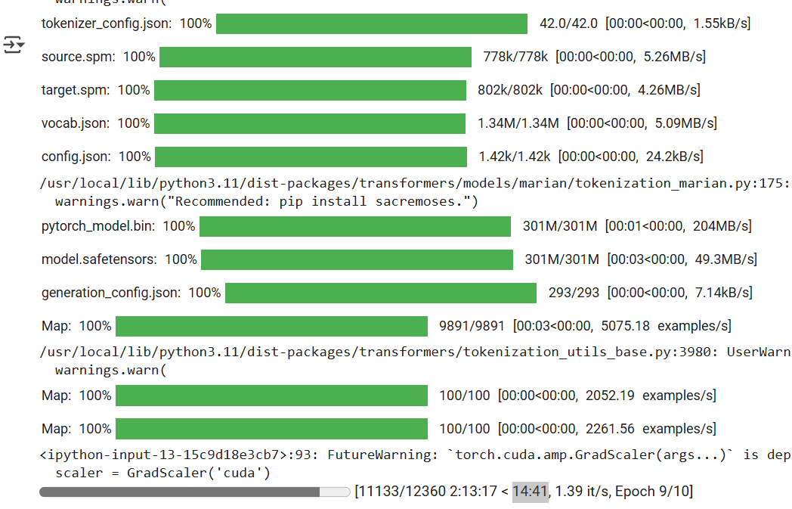
Training Model

Slide 18
Metrics Overview
Metrics: BLEU (n-gram overlap), ROUGE (structural similarity), METEOR (semantic accuracy).
BLEU: Focuses on precision of translated phrases.
ROUGE: Measures overlap in unigrams (ROUGE-1) and longest sequences (ROUGE-L).
METEOR: Accounts for synonyms, stemming for better semantic evaluation

Slide 19
Evaluation - Process
Model set to evaluation mode to disable training-specific layers.
Generated translations: Beam search with 8 beams for quality.
Beam search settings: Length penalty 1.2, no-repeat n-grams (size 3).
Managed memory: Cleared GPU after each batch to avoid crashes.

Slide 20
Primary Metrics
BLEU Score: 53.9208, indicating strong n-gram overlap.
ROUGE-1: Precision 0.7628, Recall 0.7685, F1 0.7619 (high structural similarity).
ROUGE-L: Precision 0.7587, Recall 0.7642, F1 0.7578 (consistent longest matches).
METEOR Accuracy: 0.7063, showing good semantic fidelity.

Slide 21
Results - Additional Metrics
Token-Level Precision: 0.7562, Recall: 0.7280 (vocabulary overlap).
Token-Level F1: 0.7418, reflecting balanced precision/recall.
Evaluation Loss: 0.9986, low value indicates effective training.
Average METEOR: 0.7063 across all test samples, consistent performance.

Slide 22
Visualizations - Loss and Accuracy
Plotted training and validation losses against epochs.
Losses decreased steadily, converged around epoch 8 (early stopping).
METEOR-based accuracy improved, peaked at 0.7063.
Visualization saved as loss_accuracy_visualization.png for review.

Slide 23
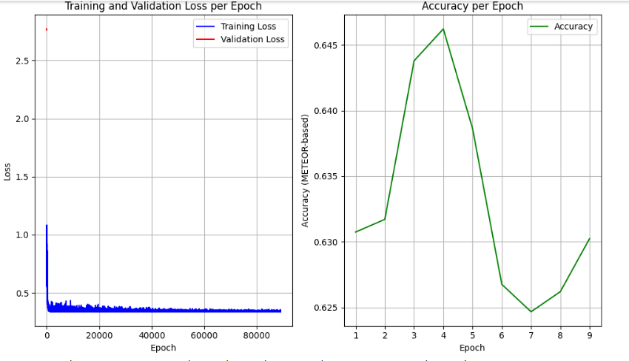
Visualizations - Loss and Accuracy

Slide 24
Visualizations - Metrics
Bar plot: Compared BLEU, Accuracy, Precision, Recall, Loss.
BLEU (53.9208) highest, reflecting strong translation quality.
Evaluation loss (0.9986) low, confirming effective training.
Saved as metrics_visualization.png with labels and grid.

Slide 25
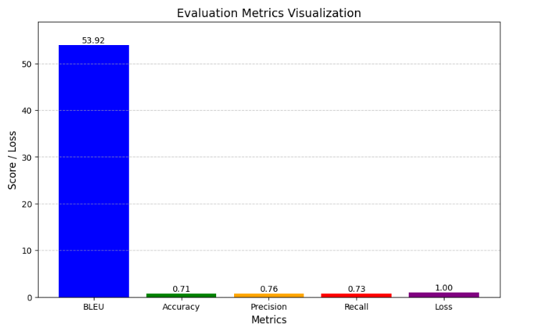
Visualizations - Metrics

Slide 26
Analysis - Strengths & Performance
Strengths: High BLEU (53.9208) for common phrases, ROUGE-1 F1 (0.7619) for structure.
Semantic accuracy: METEOR 0.7063, good for meaning preservation.
Performance: Inference time < 1 second (0.5s short, 1s complex sentences).
Memory usage: < 200 MB (100 MB short, 200 MB complex), scalable.

Slide 27
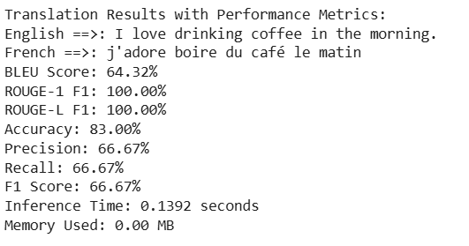
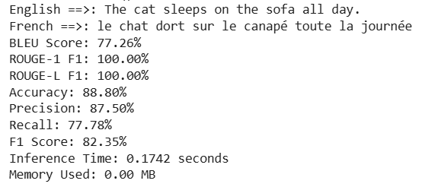
Testing Sentences

Slide 28
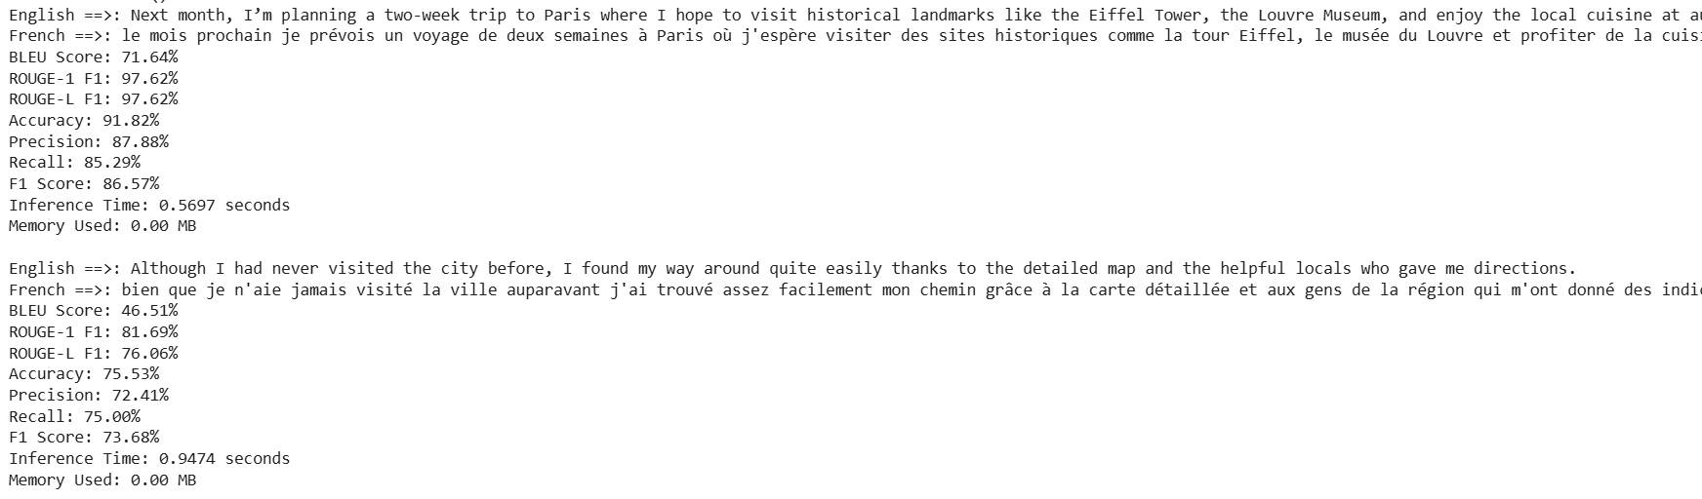
Testing Sentences

Slide 29


